Slide 1
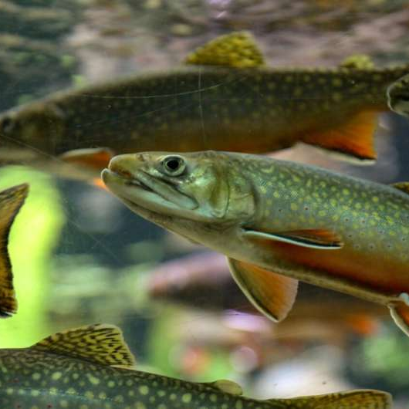
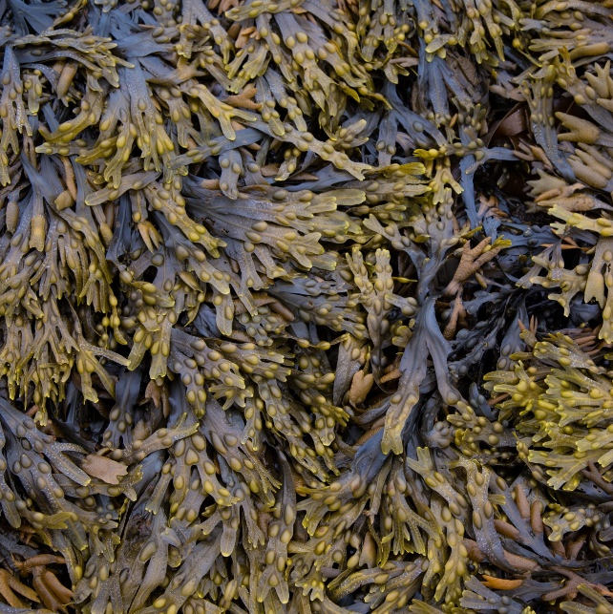
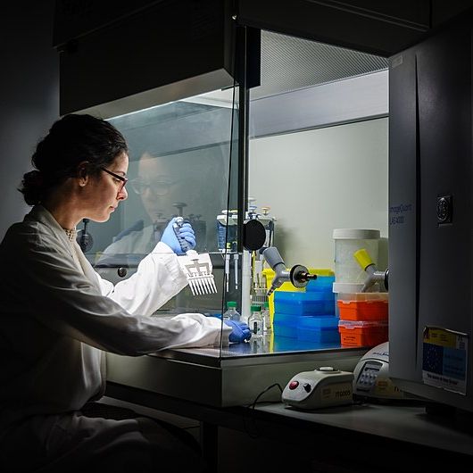
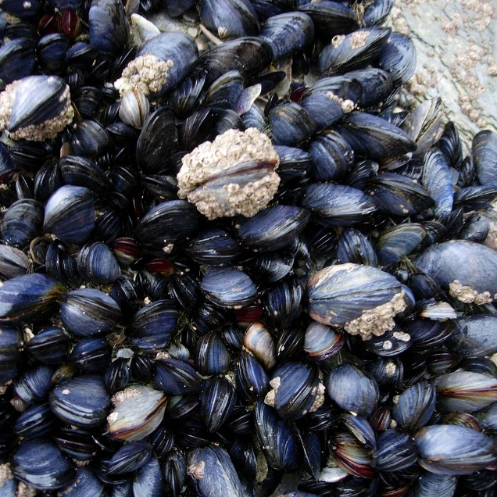
Access and Benefit-Sharing (ABS): the Nagoya Protocol and beyond
Martin Brink
9 July 2024

Slide 2

Access and Benefit-Sharing (ABS): the Nagoya Protocol and beyond
Access and Benefit-Sharing (ABS)
International ABS agreements
Implementation of the Nagoya Protocol in the EU and NL
Implications for users
New developments
Key messages

Slide 3
Access and Benefit-Sharing (ABS): the Nagoya Protocol and beyond
Access and Benefit-Sharing (ABS)
International ABS agreements
Implementation of the Nagoya Protocol in the EU and NL
Implications for users
New developments
Key messages

Slide 4


Access and Benefit Sharing (ABS)
What is Access and Benefit Sharing?
  regulation of access to genetic resources and traditional knowledge associated with genetic resources
  sharing of benefits from the use of these between providers and users
What does it mean for you?
  you cannot freely take and utilise genetic resources anymore (from the wild, from fields, or from collections), but usually need permission from the country where you want to take it
What forms of benefit sharing do exist?
  monetary (e.g. royalties, up-front payments)
  non-monetary (e.g. scientific co-operation, technology transfer)

Slide 5


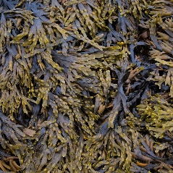
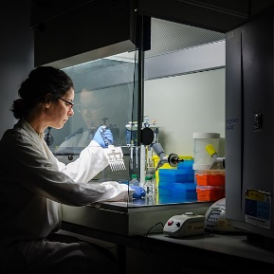
ABS: key definitions
ABS is about access to genetic resources and the sharing of benefits arising from their utilisation
  what are genetic resources?
    any material of plant, animal, microbial or other origin containing functional units of heredity, that is of actual or potential value
    except for human genetic resources
  what is utilisation of genetic resources?
    to conduct research and development on the genetic and/or biochemical composition of genetic resources, including through the application of biotechnology

Slide 6
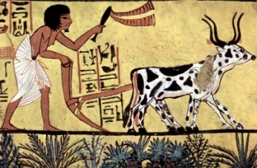
ABS is relatively new
Genetic resources were taken and exchanged freely for thousands of years
  genetic resources were considered ‘common heritage of mankind’
Second half 20th century: increasing role of Intellectual Property Rights for market products based on genetic resources (e.g. in medicine, cosmetics, plant breeding)
  products based on genetic resources were not considered ‘common heritage of mankind’
Recognition that many genetic resources from developing countries were transformed in market products in developed countries
Concept of Access and Benefit-Sharing developed

Slide 7
Access and Benefit-Sharing (ABS): the Nagoya Protocol and beyond
Access and Benefit-Sharing (ABS)
International ABS agreements
Implementation of the Nagoya Protocol in the EU and NL
Implications for users
New developments
Key messages

Slide 8
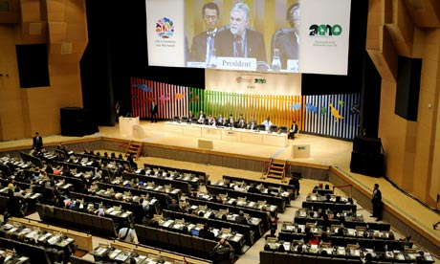
International ABS agreements
Existing
  Convention on Biological Diversity (CBD)
  Nagoya Protocol (within CBD)
  International Treaty on Plant Genetic Resources for Food and Agriculture (ITPGRFA)
  Pandemic Influenza Preparedness (PIP) Framework
Future
  ABS instrument for Digital Sequence Information (within CBD)
  International instrument on the conservation and sustainable use of marine biological diversity in areas beyond national jurisdiction (BBNJ Treaty or “Treaty of the High Seas”)
  Pathogen Access and Benefit-Sharing (PABS) System (in WHO)

Slide 9

Convention on Biological Diversity (CBD)
Negotiated in UNEP (United Nations Environment Programme)
In force since 29 December 1993
196 Parties
Objectives
  conservation of biological diversity
  sustainable use of its components
  fair and equitable sharing of the benefits arising out of the utilization of genetic resources
Important elements
  covers all genetic resources (except human material)
  affirms that states have sovereign rights over their genetic resources
  access on the basis of bilateral negotiations between the provider country and the user (unless otherwise determined by that country)

Slide 10

From CBD to Nagoya Protocol
Convention on Biological Diversity (CBD, 1993)
  genetic resources no longer considered ‘common heritage of mankind’
    instead, all states have national sovereign rights over their genetic resources
National ABS legislation established
  e.g. Philippines (1995), Costa Rica (1998), Brazil (2001), but:
    rules often unclear and complex
    enforcement difficult
Implications
  access to genetic resources limited
  little benefit-sharing
Nagoya Protocol (2014)

Slide 11
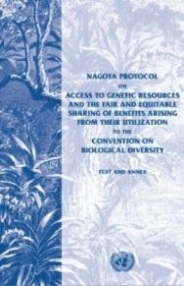
Nagoya Protocol
Protocol to the CBD
In force since 12 October 2014
141 Parties (as of 9 July 2024)
Objective
  the fair and equitable sharing of the benefits arising from the utilization of genetic resources (...), thereby contributing to the conservation of biological diversity and the sustainable use of its components
Important elements
  user countries: monitoring of ‘compliance’ of their users
  provider countries: clear and transparent access procedures
  benefit-sharing agreed through bilateral negotiations between provider country and user

Slide 12

The Nagoya Protocol
Principles
  Provider countries are to ensure clear and transparent procedures
  compliance to ABS rules in provider countries is to be monitored by the countries where the genetic resources are utilized
Access to genetic resources on the basis of
  Prior Informed Consent (PIC): permission by authorities of the country providing genetic resources
    unless otherwise determined by that country
  Mutually Agreed Terms (MAT): contract with provider
    including benefit-sharing arrangements
Also provisions on traditional knowledge associated with genetic resources and derivatives; opinions on Digital Sequence Information (DSI) differ

Slide 13
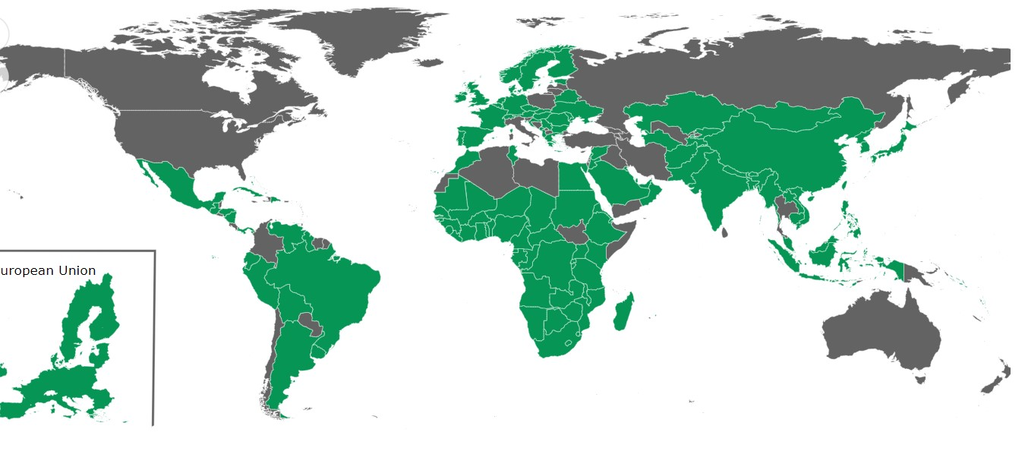
Parties to the Nagoya Protocol
(9 July 2024)

Slide 14
Access and Benefit-Sharing (ABS): the Nagoya Protocol and beyond
Access and Benefit-Sharing (ABS)
International ABS agreements
Implementation of the Nagoya Protocol in the EU and NL
Implications for users
New developments
Key messages

Slide 15


Implementation Nagoya Protocol in EU and NL
EU
  The EU ABS Regulation (Regulation (EU) 511/2014)
    published in 2014; legally binding
  Implementing Regulation (EU) 2015/1866
    published in 2015; legally binding
  Guidance document
    published in 2016; revised 2021; gives explanations, not legally binding
NL
  Nagoya Protocol (Implementation) Act
    published in 2015

Slide 16
The EU ABS Regulation (Regulation (EU) 511/2014)
Implements compliance aspects of the Nagoya Protocol in the EU
  only deals with compliance, NOT with access
  access regulated by individual countries, not at EU level
Entry into force: 12 October 2014
  Applies to genetic resources
    accessed from 12 October 2014 onwards
    accessed from a country that is a Party to the Nagoya Protocol and has established access measures
    utilised in R&D within the EU (commercial and non-commercial)
  Legally binding for all companies, institutions and individuals within the EU
  National legislation in provider countries may go further than the EU ABS Regulation

Slide 17

The EU ABS Regulation:
User obligations (Art. 4)
  To exercise ‘due diligence’ to ascertain that the genetic resources (and associated traditional knowledge) they utilise have been legally acquired, and that benefits are shared
  To utilise and transfer genetic resources in accordance with the MAT (Mutually Agreed Terms)
  Therefore:
    seek relevant ABS information
    obtain required permits and contracts
    keep ABS information for 20 years after end utilisation
    transfer relevant ABS information to subsequent users

Slide 18
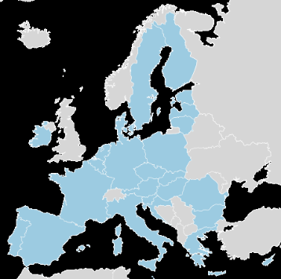
The EU ABS Regulation:
Member State obligations (Art. 7, 9, 11)
  Lay down rules on penalties in case of non-compliance
    “effective, proportionate and dissuasive”
  Carry out checks to monitor compliance of users
  Request users to submit a ‘due diligence declaration’
    when external funding is received for research project using genetic resources
    at the stage of final development of a product developed via the utilisation of genetic resources

Slide 19
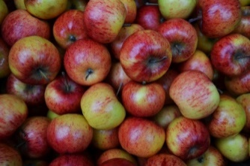
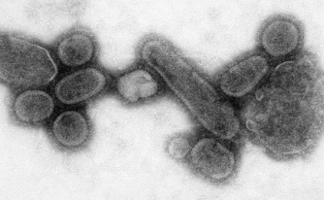
The EU ABS Regulation:
Specialised International Instruments (Art. 2)
  The EU ABS Regulation does not apply when ABS of genetic resources is covered by a ‘Specialised International Instrument’ (Art. 2)
  Instruments recognized by the EU:
    International Treaty on Plant Genetic Resources for Food and Agriculture (ITPGRFA)
      plant genetic resources for food and agriculture
    Pandemic Influenza Preparedness Framework (PIP-framework)
      influenza viruses with human pandemic potential
In the future probably more specialised international instruments will be recognized

Slide 20

Implementing Regulation (EU) 2015/1866
Entry into force: 9 November 2015
Legally binding
Lays down more detailed rules on the implementation of certain articles of the EU ABS Regulation
  due diligence declarations
  EU register of trusted collections
  Best practices
Annexes:
  information to be provided
  templates

Slide 21

EU Guidance Document
First version 2016; revised version 2021
Not legally binding; explains EU ABS Regulation
Explanation ‘utilisation’ = basic research, applied research and/or product development
  if an activity creates new insight into characteristics of the genetic resource which is of (potential) benefit to the further process of product development, it falls under the term ‘utilisation’
Two main parts
  main text
  Annex 2

Slide 22
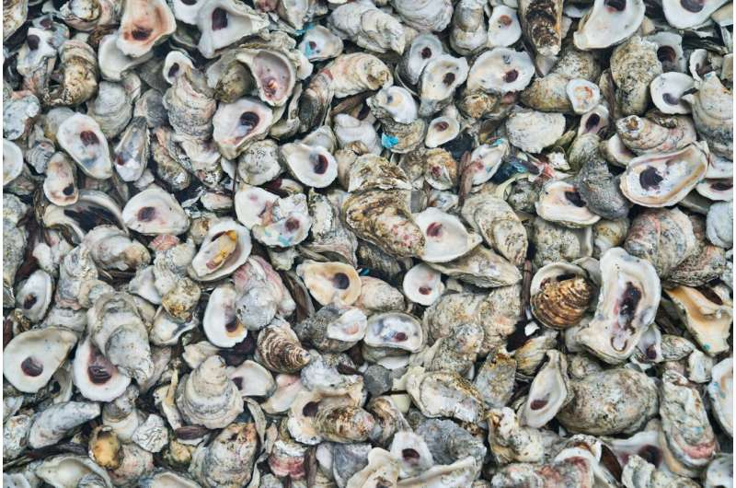
EU Guidance Document: Main text
  Introduction
  Scope of the EU ABS Regulation
  Obligations of users
    due diligence obligation
    specific situations
  Events triggering due diligence declarations
    external research funding
    final development of product
  Sector specific issues
    health
    food and agriculture

Slide 23
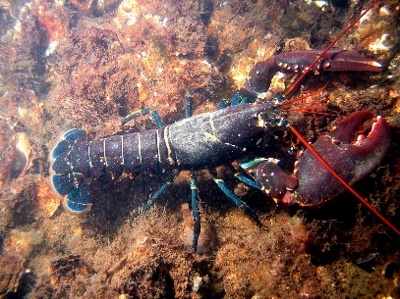
EU Guidance Document: Scope
EU ABS Regulation (cumulative)
  Geographic scope
    applicable to GR from countries which are a Party to the Nagoya Protocol and have established access measures
    applicable to utilisation within EU territory
  Temporal scope
    applicable to GR accessed from 12 Oct 2014 onwards
  Material scope
    applicable to the utilisation of genetic resources and of traditional knowledge associated with GR
    utilisation (R&D) includes basic research, applied research and product development
  Personal scope
    applicable to all users of GR resources

Slide 24

EU Guidance Document: What is utilization?
Important element of the main text is about the question: what is ‘utilisation’? (section 2.3.3)
Examples of ‘utilisation’
  research to discover specific genetic and/or biochemical properties
  creation and improvement of genetic resources to be used in production processes
  genetic modification
Examples of ‘no utilisation’
  exchange of genetic resources as commodities
  genetic resources as testing/reference tools
  maintenance and management of a collection for conservation purposes (including te quality/phytopathology checks)

Slide 25
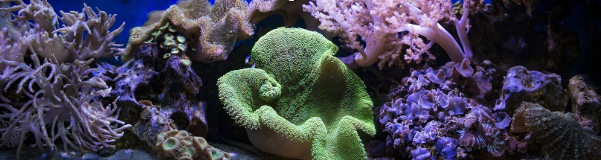
EU Guidance Document: Annex II
  Provides specific guidance on when genetic resources are considered to be utilised in the meaning of the EU ABS Regulation (assuming they fall in the geographical, temporal and material scopes)
  Follows logic of the value chain, starting from acquisition, through storage, collection management, identification and characterisation, to placing of a product on a market
  Contains many examples (cases) drawn from different sectors, often based on feedback from stakeholders

Slide 26

EU Guidance Document: Annex 2
  Introduction
  Acquisition
  Storage and collection management
  Rearing and multiplication
  Exchange and transfer
  Identification of organisms and other activities at the beginning of the value chain
  Genetic resources as tools
  Breeding
  Product development, processing and product formulation
  Product testing
  Marketing and application

Slide 27
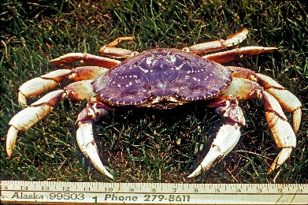
EU Guidance Document: Identification and phylogenetic analysis
Identification and characterization of organisms and other activities at the beginning of the value chain (Annex II, chapter 6)
  Taxonomic identification, characterization or description of genetic resources: no utilisation in the meaning of the EU ABS Regulation
    When, however, combined with research on its specific genetic and/or biochemical composition, specifically the function of the genes, it is considered utilisation
  Phylogenetic analysis: no utilization, as long as it does not entail research and development of the genes, and the function of the genes or DNA sequences is not investigated

Slide 28
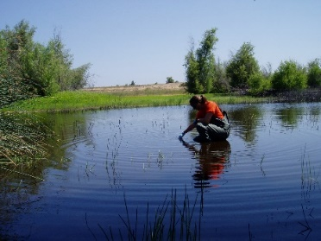
Case ‘Identification’
  Environmental DNA metabarcode analysis of water samples to discover the numbers of fish species present
  Water samples are taken from a river to discover the number of different fish species present. It makes use of DNA released into the water by organisms. To obtain a biodiversity inventory the DNA is purified from the water samples, DNA markers are targeted and sequenced, and the sequences discovered are taxonomically assigned by comparison with reference sequences in a database. The
  function of the genes is not investigated.
  Is this ‘utilization’ in the meaning of the EU ABS Regulation?

Slide 29
Case ‘Identification’
  Environmental DNA metabarcode analysis of water samples to discover the numbers of fish species present
  Because only the sequence is used, and the functions are not studied or considered, such inventory studies do not constitute utilisation under the EU ABS Regulation.
  So, this activity is no ‘utilization’ in the meaning of the EU ABS Regulation

Slide 30
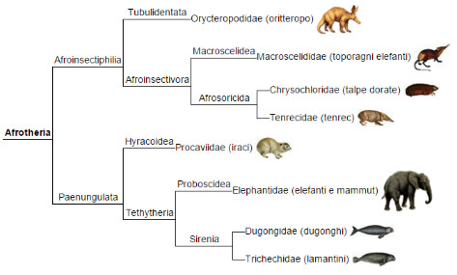
Case ‘Phylogenetic analysis’
  Phylogenetic analyses without consideration of function of genes
  A taxonomist studies a group of organisms in preparation of a floristic treatment or taxonomic monograph. As a part of the descriptive process, the taxonomist creates a phylogeny of the taxa involved, using morphological and DNA sequence information obtained from specimens in a collection. This is done without additional research on the genetic resource to discover specific genetic functions of the genes analysed. The morphological and sequence information is used in a descriptive manner and to recognise taxa at strain, species, or higher levels.
  Is this phylogenetic analysis to be considered ‘utilization’ in the meaning of the EU ABS Regulation?

Slide 31
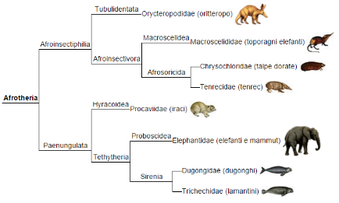
Case ‘Phylogenetic analysis’
  Phylogenetic analysis without consideration of function of genes
  The phylogeny is used to provide a classification. This does not qualify as utilisation in the meaning of the EU ABS Regulation. If the taxonomist would make use of the function of the genes in the phylogenetic analysis, this activity would qualify as utilisation in the meaning of the EU ABS Regulation.
  So, this phylogenetic analysis is no ‘utilization’ in the meaning of the EU ABS Regulation

Slide 32
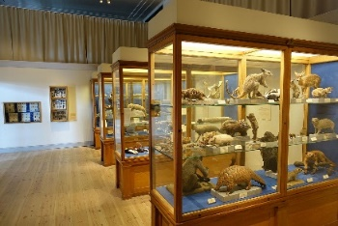
EU Guidance Document: Storing and collection management
Annex II, chapter 3: Storing and collection management
  Storing genetic resources in a public or private collection does not constitute utilisation in the sense of the EU ABS Regulation
  Verification the identity of genetic resources and assessing their health status and the presence of pathogens form an integral part of collection management and are not considered to be utilisation in the meaning of the EU ABS Regulation
  General good practice of collection holders upon receiving material is to check if the original permits for collecting genetic resources allow supply to third-party users
    if so: make the information on the permits available for potential users and to supply it together with any material to the potential users

Slide 33

Case ‘Storing and collection management’
  Storage of pathogens pending a decision on their use in a vaccine
  Different pathogens are isolated from hosts in various countries as part of global surveillance systems and considered from epidemiological analysis to be a potential public health threat. Initial analysis does not make it clear which, if any, of the isolates will be needed for vaccine development. However, the threat is considered sufficiently great that preparation of vaccines and diagnostics is requested by WHO and by individual governments around the world. Therefore, these pathogens are collected and stored in an already existing collection, as well as exchanged with other collections.
  Is the storage of pathogens ‘utilization’ in the meaning of the EU ABS Regulation?
  Is the development of vaccines on the basis of these stored pathogens ‘utilization’ in the meaning of the EU ABS Regulation?

Slide 34
Case ‘Storing and collection management’
  Storage of pathogens pending a decision on their use in a vaccine
  Building up a collection of pathogens with the aim to use them in case of further needs is not considered to constitute utilisation in the meaning of the EU ABS Regulation. However, if at a later stage the vaccine candidates are used to develop a vaccine, this is research and development on the genetic or biochemical composition of the genetic resource and such activity would fall within the scope of the EU ABS Regulation.
  So, the storage of pathogens is no ‘utilization’ in the meaning of the EU ABS Regulation
  The development of vaccines on the basis of these stored pathogens, on the other hand, is ‘utilization’ in the meaning of the EU ABS Regulation

Slide 35
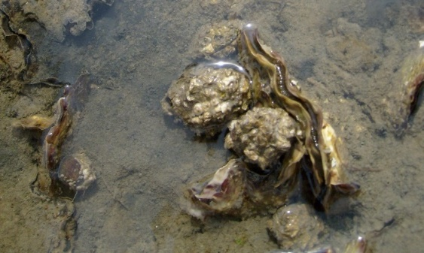
EU Guidance Document:
Alien species
Main text, section 2.1.4: Alien and invasive alien species
  Alien species once established (i.e. self-sustaining in the wild) are considered as occurring in in-situ conditions in the country to which they are not native and into which they have been introduced or spread from another country.
  Alien organisms that are established in situ fall under sovereign rights of the country where they are established.
  In this case, the country where access from in situ conditions takes place is the country whose rules should be followed.

Slide 36
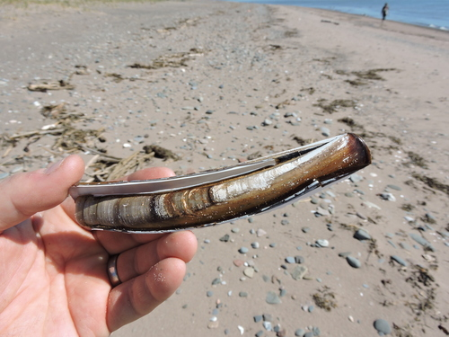
Case ‘Introduced species’
  Investigation of function of genes: established introduced species
  A species of fish was intentionally introduced from one country to another in the 1960s for fishing and has established a viable population in the second country. Fresh specimens of the fish from the second country are obtained by a research consortium wishing to sequence the genome of the species and publish a genome map annotating the genes and their functions.
  1. Is this ‘utilization’ in the meaning of the EU ABS Regulation?
  2. Which country is the provider country?

Slide 37
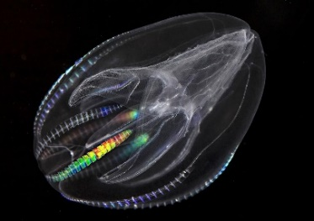
Case ‘Introduced species’
  Investigation of function of genes: established introduced species
  1. The research activity qualifies as research and development on the genetic and/or biochemical composition of the genetic resources and thus constitutes utilisation in the meaning of the EU ABS Regulation.
  2. Because the fish is established in the second country and the specimens were accessed from in situ conditions in that country, the second country is to be considered as the provider country, and the user should contact that country to clarify whether requirements to obtain prior informed consent and establish mutually agreed terms apply.
  So, 1. this activity is ‘utilization’ in the meaning of the EU ABS Regulation, and 2. the second country is the provider country

Slide 38
National legislation NL
Nagoya Protocol (Implementation) Act (with Explanatory Memorandum, Regulation and Decrees)
  implements Nagoya Protocol in NL
  into force: 23 April 2016
  Competent National Authority (CNA): Ministry of Economic Affairs (now: Ministry of Agriculture, Nature and Food Quality)
  monitoring agency: Netherlands Food and Consumer Product Safety Authority (NVWA)
  National Focal Point (NFP): Centre for Genetic Resources, the Netherlands (CGN)
  Access to Dutch genetic resources not regulated: Prior Informed Consent (PIC) not needed

Slide 39

National legislation NL: Sanctions
Nagoya Protocol (Implementation) Act
  Art.6: Minister may take immediate interim measures, e.g.
    confiscation of genetic resources or products developed
    prohibiting further use
    return of genetic resources to the provider country
  Art.8: actions contrary to the law seen as an ‘economic offence’
Both criminal and administrative law possible
  administrative law: fine
  criminal law: fine, community service, detention (according to Economic Offences Act)
Intervention policy NVWA
  lesser offence (unconscious and easily correctable)
    warning with re-check after a few months
  serious offence (conscious and/or unrecoverable)
    corrective intervention and/or official report

Slide 40
Access and Benefit-Sharing (ABS): the Nagoya Protocol and beyond
Access and Benefit-Sharing (ABS)
International ABS agreements
Implementation of the Nagoya Protocol in the EU and NL
Implications for users
New developments
Key messages

Slide 41

What to do as a user?
  Check the access rules of the provider country
    ABS Clearing House (https://absch.cbd.int/)
    National Focal Point (NFP) of the provider country
  Check if the material can be obtained through a specialised international ABS instrument (ITPGRFA; PIP Framework).
    If yes, sign a Standard Material Transfer agreement (SMTA)
    If no, continue with 3-8
  If required, seek permission from the Competent National Authority (CNA) of the provider country (PIC: ‘Prior Informed Consent’)
  Negotiate conditions with provider, and lay these down in a contract (MAT: ‘Mutually Agreed Terms’)

Slide 42
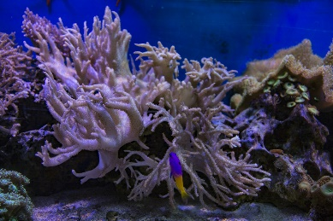
What to do as a user in the EU?
  Use the genetic resources only in accordance with the conditions agreed with the provider and laid down in the MAT
    if the intended use changes, new PIC and MAT may need to be obtained
  Carefully document the use
  Keep all documentation for 20 years after the end of utilisation
  Submit a ‘due diligence declaration’ (through https://webgate.ec.europa.eu/declare/) when you
    receive external research funding, or
    bring a product on the market
  Pass on information to further users of the genetic resources

Slide 43

What to document?
Internationally-recognised certificate of compliance (placed by provider country on the ABS Clearing House website)
OR
Information/documents on:
  date and place of access of resources or traditional knowledge;
  description of the genetic resources or of traditional knowledge;
  source from which the genetic resources or traditional knowledge associated with genetic resources were obtained, as well as subsequent users (development chain);
  rights and obligations relating to access and benefit-sharing including for subsequent applications and commercialisation;
  access permits, where applicable (Competent National Authority);
  mutually agreed terms, including benefit-sharing arrangements, where applicable

Slide 44

Some further points of attention
In the EU ABS Regulation, the user is responsible for compliance, not the supplier
  if genetic resources for R&D are bought from a trader, request access documentation
The utilisation in R&D of genetic resources bought abroad from a local market may also fall under the EU ABS Regulation
Some EU countries have access legislation
  the obligations of the EU ABS Regulation may also apply to material from these EU countries
USA is not foreseen to join the Nagoya Protocol
  EU ABS Regulation rules do not apply to US genetic resources (but only if they are really from USA)
National legislation in provider countries may go further than the EU ABS Regulation

Slide 45

Some recommendations
Seek advice and help from local counterparts
Find out if the genetic resource can be obtained
  under a specialised international instrument (ITPGRFA, PIP-Framework)
  from a collection included in the EU Register
Try to conclude a framework agreement between your organisation and the provider country
Keep documentation on genetic resources that do not fall under the EU ABS Regulation, to make plausible that these were legally accessed
Take ABS aspects into account from the very start of the project

Slide 46
Access and Benefit-Sharing (ABS): the Nagoya Protocol and beyond
Access and Benefit-Sharing (ABS)
International ABS agreements
Implementation of the Nagoya Protocol in the EU and NL
Implications for users
New developments
Key messages

Slide 47

New developments
International instrument on Digital Sequence Information (DSI)
International instrument on the conservation and sustainable use of marine biological diversity in areas beyond national jurisdiction (BBNJ)
Enhancement of the Multilateral System of the International Treaty on Plant Genetic Resources for Food and Agriculture (ITPGRFA)
Pathogen Access and Benefit-Sharing (PABS) System

Slide 48

Digital Sequence Information (DSI)
Genomic information is increasingly used in R&D, in addition to or even instead of genetic resources
  some countries fear that this will lead to decreased benefit-sharing from the use of genetic resources
International discussion arose on the question if the use of so-called Digital Sequence Information” (“DSI”) should also be subject to ABS obligations, similar to the use of genetic resources
Research sector stresses that the bilateral Nagoya system is not suitable for “DSI”, because the use of “DSI” is very different from the use of genetic resources
Some developing countries have already included “DSI” in their domestic ABS legislation

Slide 49
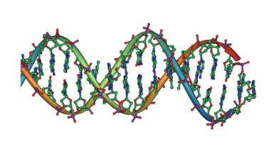
Digital Sequence Information (DSI)
“DSI” is discussed in various international fora, e.g.
  Convention on Biological Diversity (CBD) / Nagoya Protocol
  International instrument on the conservation and sustainable use of marine biological diversity in areas beyond national jurisdiction (BBNJ)
  World Health Organization (WHO)
  International Treaty on Plant Genetic Resources for Food and Agriculture (ITPGRFA)
Main discussion forum: CBD
Term “DSI” not defined, but used as ‘placeholder’
  primarily refers to information on the genetic composition of organisms

Slide 50

Digital Sequence Information (DSI)
CBD meeting Montreal, December 2022
  ABS-system for DSI will fall under CBD and not under Nagoya Protocol; will not follow the bilateral approach of the Nagoya Protocol, but basically a multilateral approach
    benefit-sharing decoupled from access
    global fund for benefit-sharing
  Some principles agreed upon, including:
    consistent with open access to data
    effective, efficient, feasible and practical
    certainty and legal clarity for providers and users
    not hinder research and innovation
Follow-up process in CBD
  Working Group to develop system for DSI
  Next meeting of Working Group: 12-16 August, Montreal
  Decision expected in CBD meeting in October/November 2024
Further CBD discussions in June; decisions probably taken during CBD meeting in August-September

Slide 51
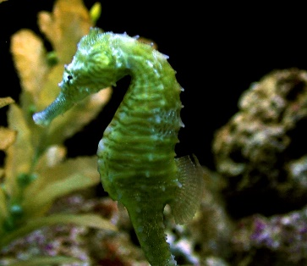
BBNJ Treaty (“Treaty of the High Seas”)
BBNJ Treaty: “International instrument on the conservation and sustainable use of marine biological diversity in areas beyond national jurisdiction”
Is about activities with marine biological diversity in areas beyond national jurisdiction
Adopted on 19 June 2023
  will enter into force after ratification by 60 Parties
  by June 2024, 8 Parties had ratified
Covers four main issues:
  marine genetic resources, incl. the fair and equitable sharing of benefits
  measures such as area-based management tools, including marine protected areas
  environmental impact assessments
  capacity-building and the transfer of marine technology

Slide 52

BBNJ Treaty (“Treaty of the High Seas”)
Includes ABS provisions for marine genetic resources in areas beyond national jurisdiction and associated DSI
  notification of activities mandatory
  Benefit-Sharing through a financial mechanism, decoupled from access
  Benefit-Sharing Fund initially filled through contributions by countries; future modalities will be further discussed
This means:
  ABS for marine genetic resources in areas under national jurisdiction remain under CBD / Nagoya Protocol
  ABS for marine genetic resources in areas beyond national jurisdiction will fall under BBNJ

Slide 53
Access and Benefit-Sharing (ABS): the Nagoya Protocol and beyond
Access and Benefit-Sharing (ABS)
International ABS agreements
Implementation of the Nagoya Protocol in the EU and NL
Implications for users
New developments
Key messages

Slide 54



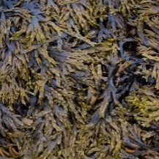
Key messages
The concept of Access and Benefit Sharing (ABS) was already established by the Convention on Biological Diversity (CBD) in 1993.
The Nagoya Protocol, in force since 2014, obliges countries where genetic resources are used to monitor compliance to ABS rules.
The EU ABS Regulation, in force since 2014, is a European law that implements the compliance aspects of the Nagoya Protocol in the EU. It contains obligations for users and for governments in the EU.
According to the interpretation of the EU ABS Regulation, ‘utilization' may include basic research, applied research and/or product development.
The EU Guidance document gives detailed explanations and examples related to the EU ABS Regulation.

Slide 55
Key messages
The ABS Regulation does not cover access rules of EU member states; these are decided upon by countries themselves.
Access to Dutch genetic resources is not regulated: Prior Informed Consent (PIC) is not needed.
National legislation in non-EU provider countries may go further than the EU ABS Regulation.
“Digital Sequence Information” (“DSI”) does not fall under the Nagoya Protocol and the EU ABS regulation, but a multilateral ABS-system for DSI will be established under the CBD.
The BBNJ Treaty (“Treaty of the High Seas”), adopted in 2023 but not yet in force, will cover genetic resources in marine areas beyond national jurisdiction.

Slide 56

More information
Website CBD / Nagoya Protocol (www.cbd.int)
  maintained by CBD/NP
  lists of Parties to CBD and NP and contact points
  Information on meetings and processes
ABS Clearing House (absch.cbd.int/)
  maintained by CBD/NP
  country information (contact persons, laws)
Website of BBNJ (https://www.un.org/bbnjagreement/en)
  maintained by United Nations
  Information on BBNJ, including text of the agreement

Slide 57
More information
ABS website of the EU (http://ec.europa.eu/environment/nature/biodiversity/international/abs/legislation_en.htm)
  maintained by European Commission
  information on EU rules
  EU registers of collections and recognized ‘best practices’
Website of National Focal Point NL (www.absfocalpoint.nl)
  bilingual (Dutch/English)
  information on rules and what to do
  interactive help tool
  news articles on new developments (e.g. DSI)
  subscription to ABS newsletter
  FAQ

Slide 58
Thank you for your attention!
www.absfocalpoint.nl
NagoyaNL@wur.nl

